Slide 1
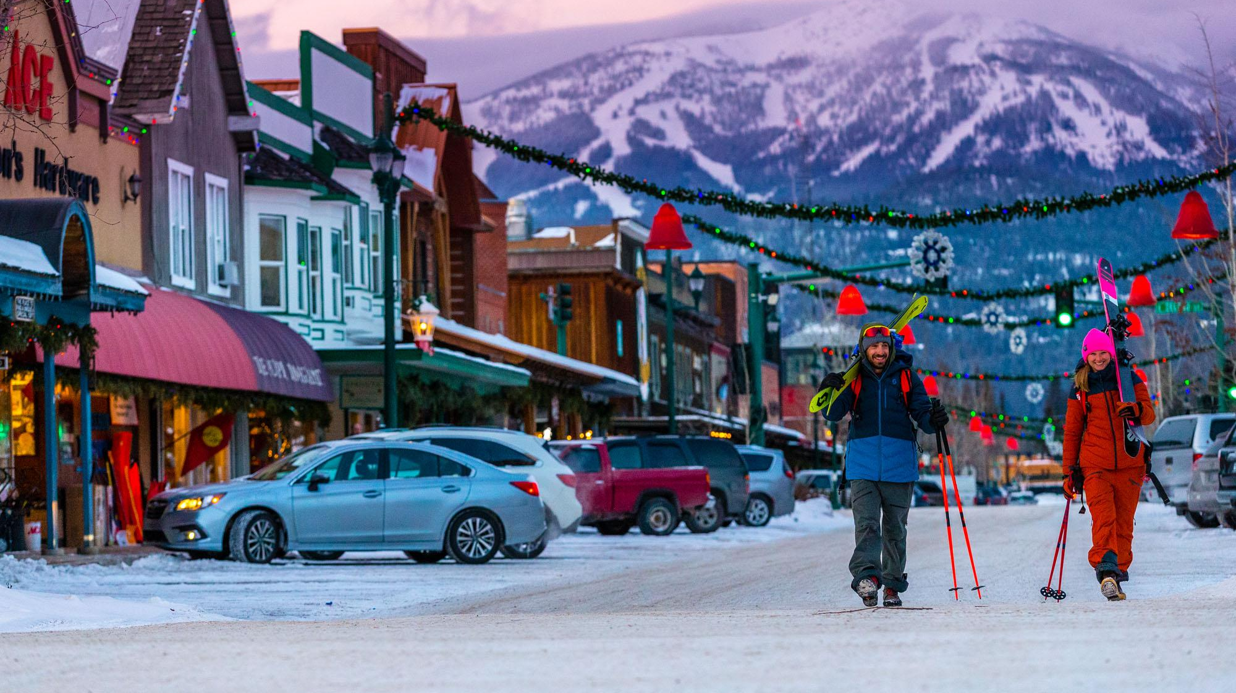
Big Mountain Ski Resort

Slide 2
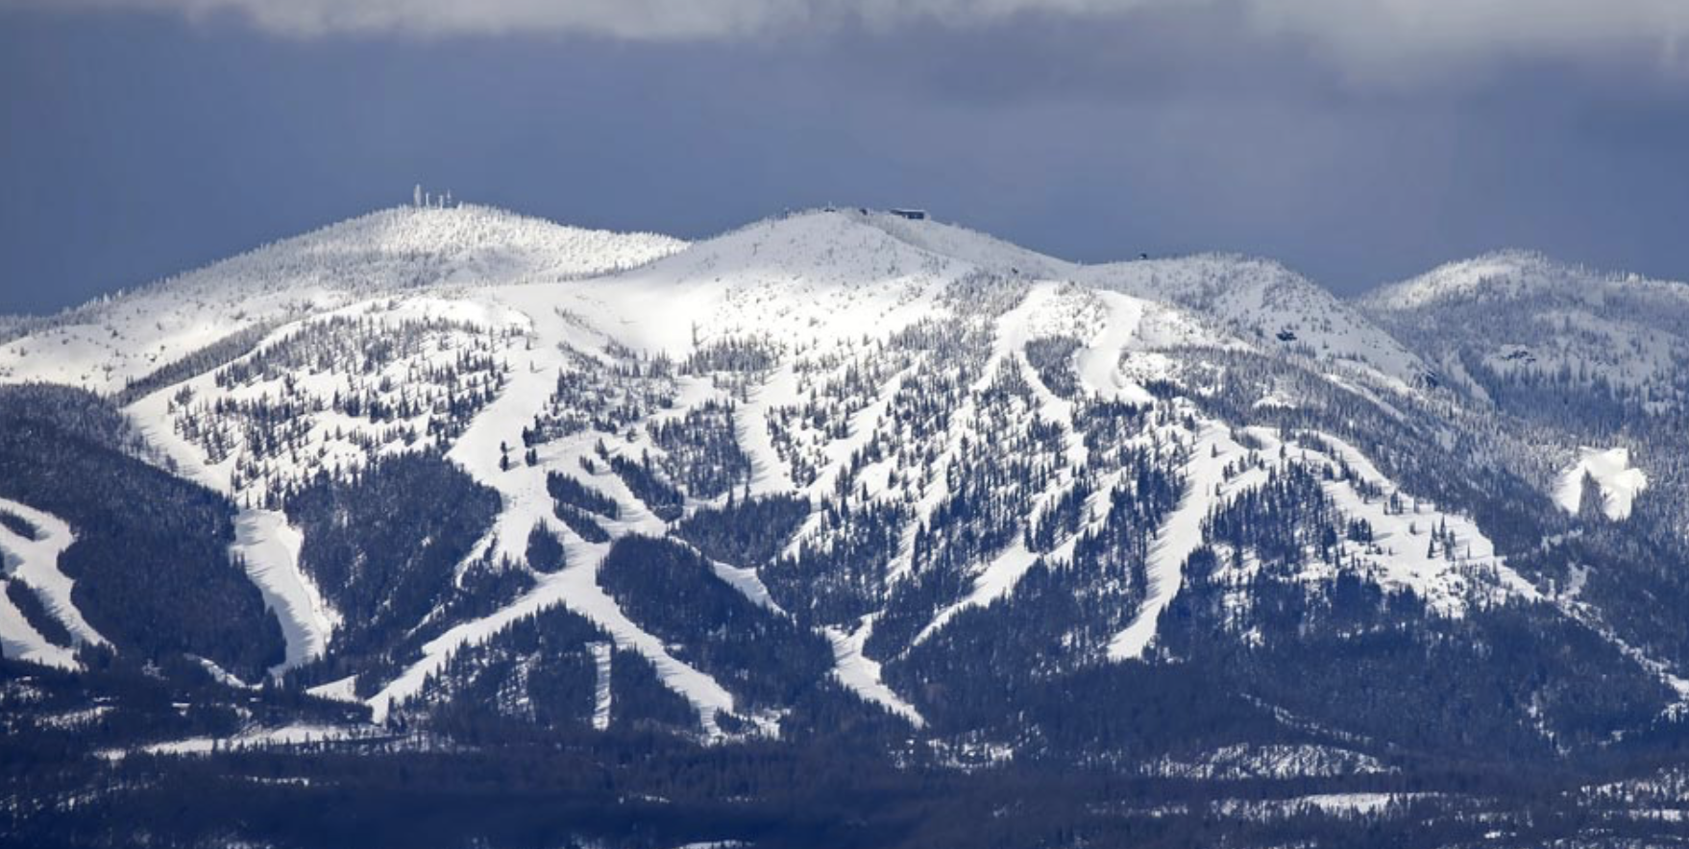
Big Mountain Ski Resort
Big Mountain is a Ski and Snowboard resort located in Whitefish Montana
Boasts 3000 acres, 105 ski trails, 11 lifts, magic carpet and it's longest run of 3.3 miles.
Gets 350,000 visitors every ski season
Services 11 lifts and one magic carpet
Longest run is 3.3 miles

Slide 3
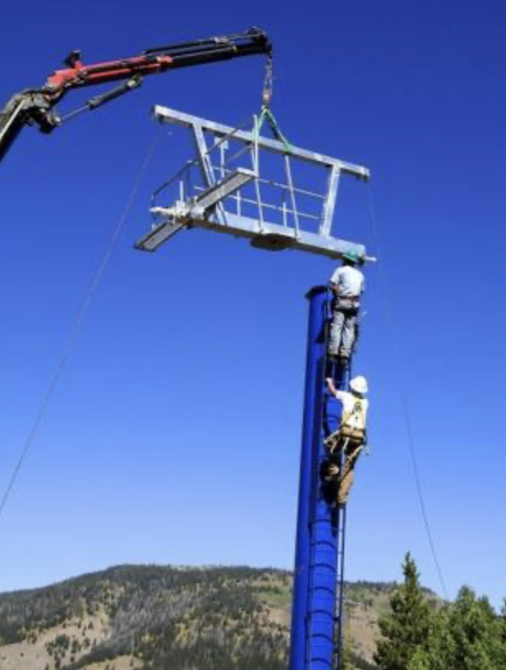
Problem Identification:
Big Moutain recently incurred an added 1.54 million dollar expense due to recent renovations.
Big Mountain would like to optimize its ticket prices in order to increase revenue by 10% and maintain costumer satisfaction by the end of the current ski season
Big Mountain would like help pricing their tickets to cover new expenses and tie it to competitors that offer similar amenities.

Slide 4
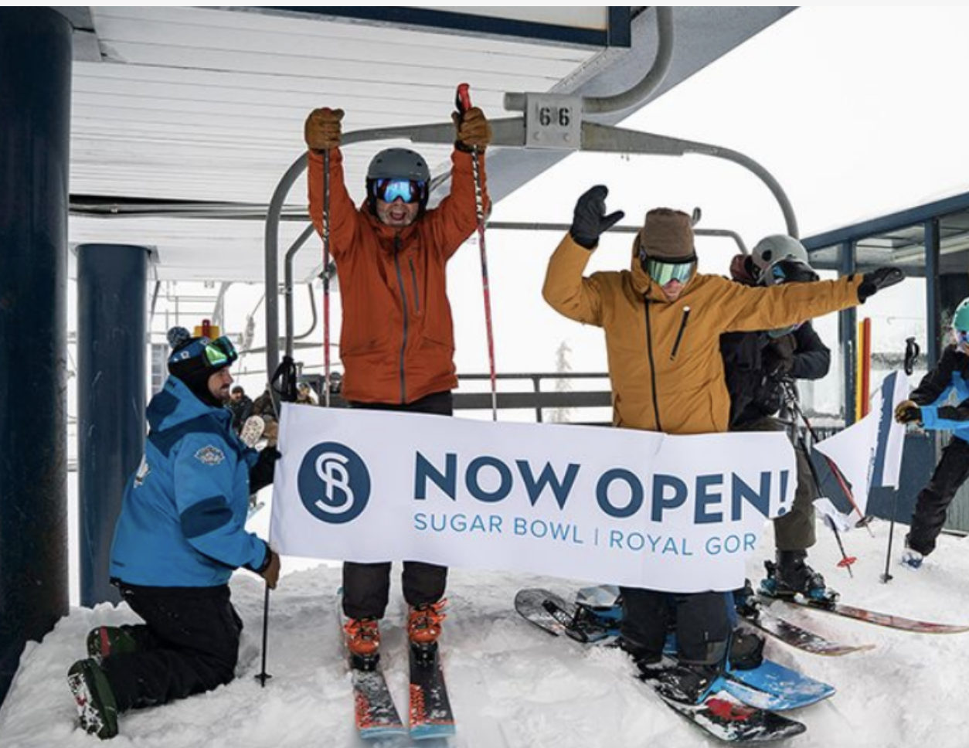
Key Findings
Pricing influences: vertical drop, number of runs and projected days open strongly Impact ticket pricing.
Competitive Analysis: Silverton Mountain in Colorado has higher prices due to a bigger skiable area.
Trends: California, Utah and Nevada have the highest ticket prices in the states. New York has the most ski resorts.
Night skiing is dominated by states in the North East.

Slide 5

Recommendations
Big mountain can increase ticket prices based on features that attract costumers (e.g. vertical drop and days open)
Implement pricing strategies to adjust ticket prices based on demand, season and competitor pricing.
Invest in other amenities that maximize visitor experience (e.g. fast quad chairs).

Slide 6
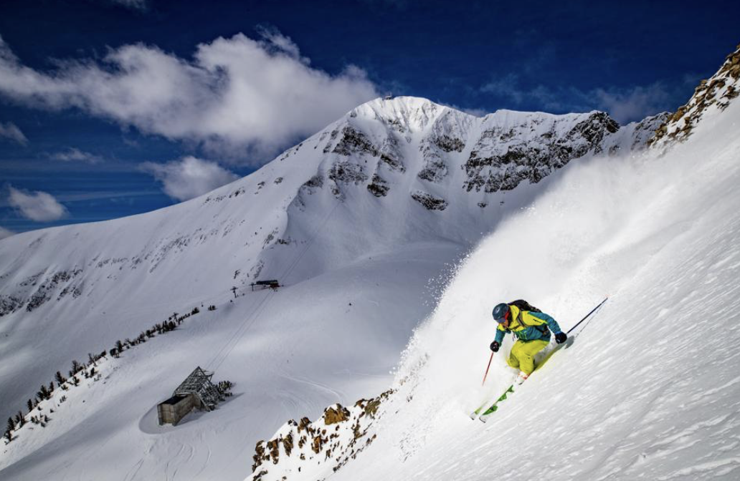
Modeling Results and Analysis
One of the features most attractive to costumers is vertical drop
Big Mountain has a good vertical drop but should take into consideration that other resorts have steeper drops.

Slide 7
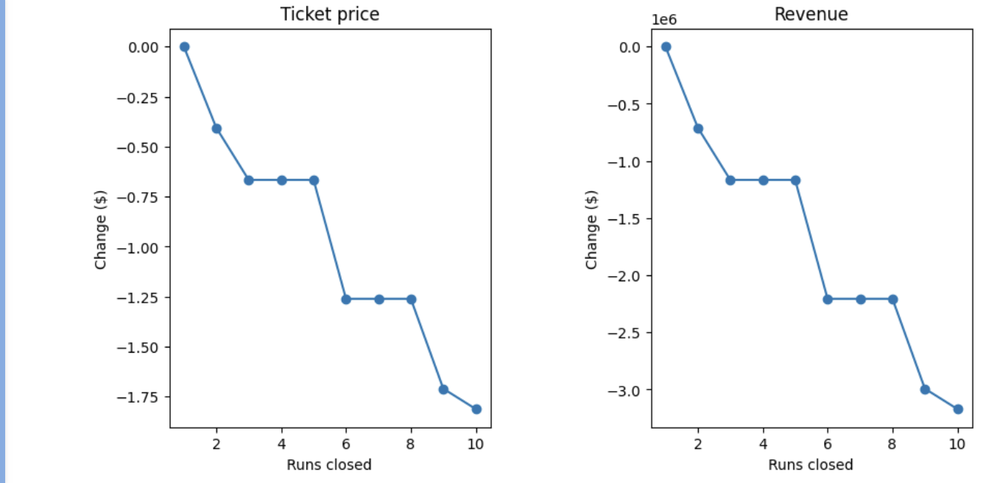
Cutting Cost by Closing Runs
Closing 3 runs can lead to closing up to 5 runs without any detriment

Slide 8
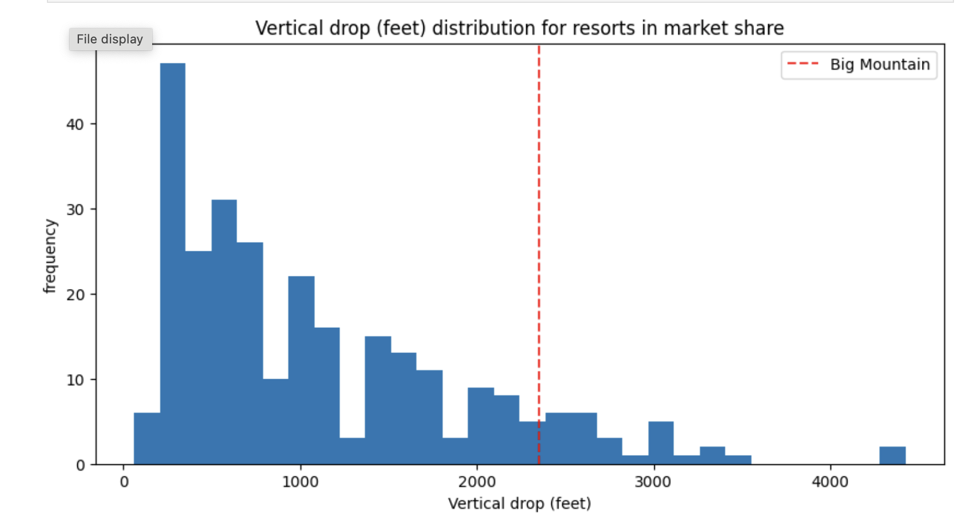
Vertical Drop
Compared to other resorts Big Mountain stacks well in vertical drop, but many still have a more inclined one.

Slide 9
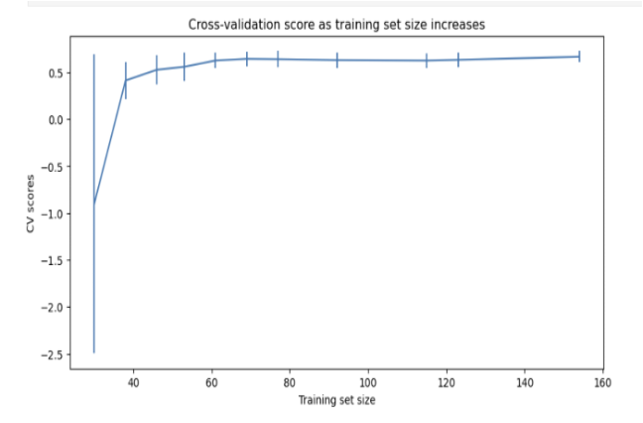
Modeling Results and Analysis
Cross-Validation Model:
●Cross-validation confirms stability, suggesting pricing adjustments based on data.
● Random Forest Regressor outperformed Linear Regression model.
●Model did not show any significance after a sample of 40 resorts

Slide 10
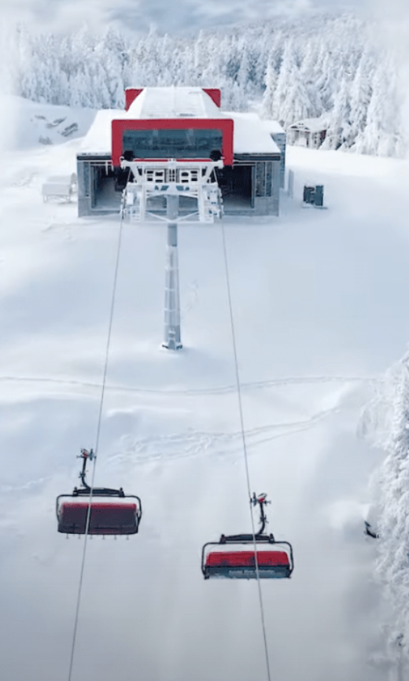
Summary
Big Mountain pricing strategy revealed that some of the most impactful features for ticket pricing are: number of runs, number of days open and vertical drop.
Random Forest Model provided the best insight when predicting ticket pricing.

Slide 11
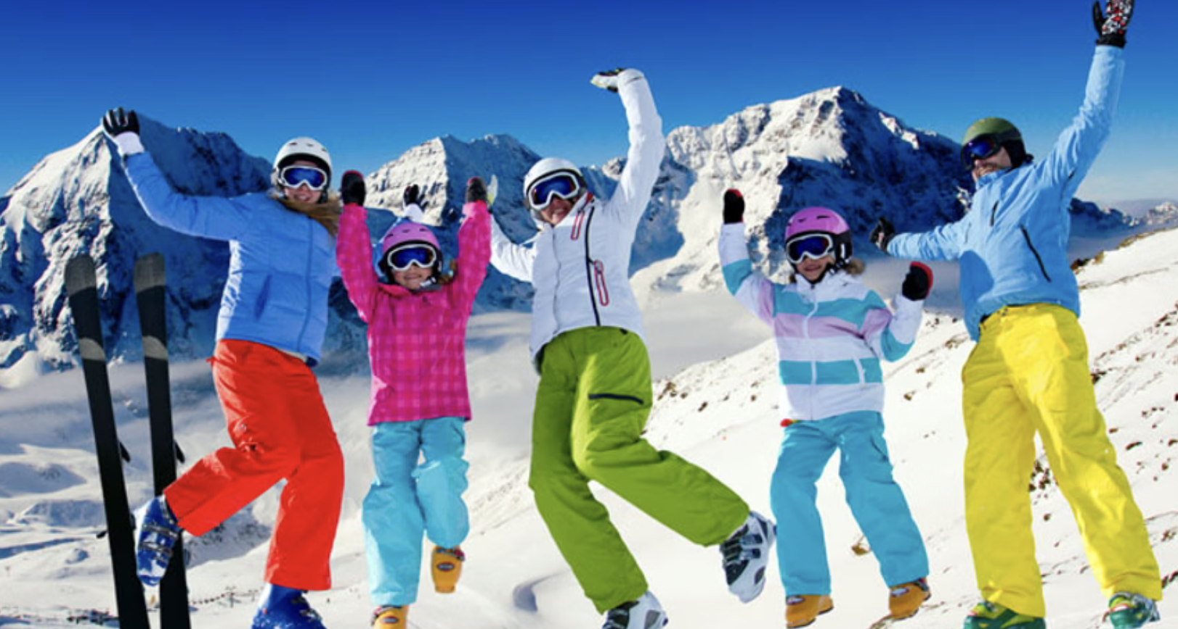
Conclusion
To optimize revenue Big Mountain Should:
Increase ticket prices based on features which costumers are willing to pay for.
Look into optimizing other infrastructure such as high speed lift chairs.
Consider implementing dynamic pricing to optimize revenue through the season.

